Slide 1

Introduction to CSE
Computer System Engineering, Fall 2019 (IPADS, SJTU)
Coping with the complexity of computer system
Yubin Xia

Slide 2
What is a System?
System =
Interacting set of components with a specified behavior at the interface with its environment
Examples
Web, Apache web server, Android, Ext-4 file system, Linux, …

Slide 3
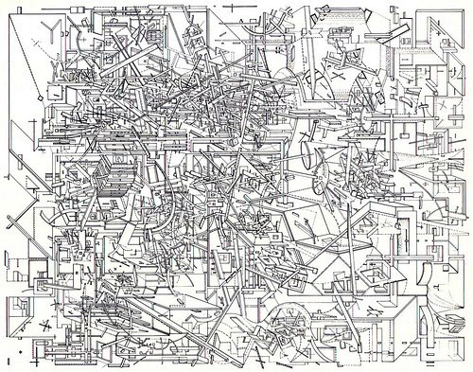
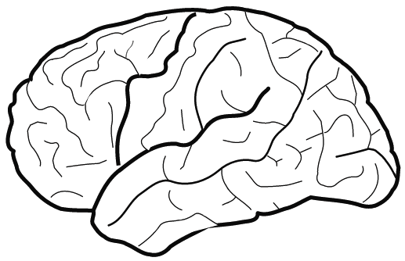
The Problem: Complexity of the Systems
Hard for human to fully understand
But, we can view from a system's perspective

Slide 4
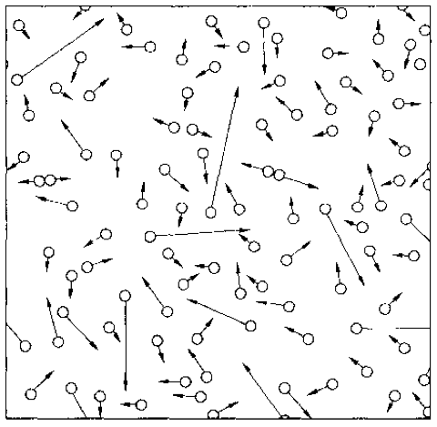
An Example: The Gas System
A systematical way to understand a complex system is needed
Notes:
system has properties that a node has not.
gas molecule properties: speed, a, m, size
gas system properties: pressure, temperature
Computer system properties: consistency, fault tolerance, performance,…

Slide 5
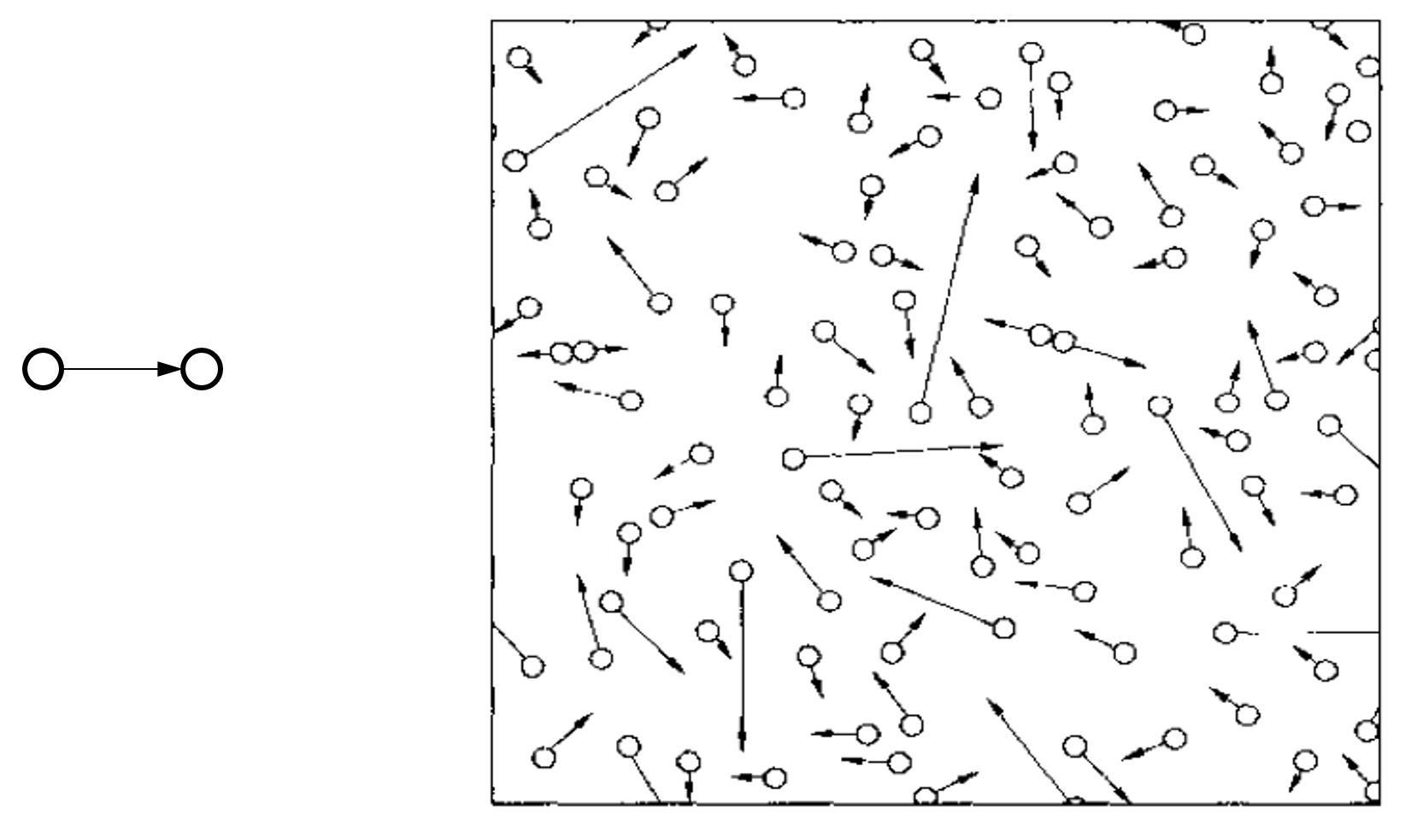
Compare with the Computer Systems
Programming / Data Structure
LoC (Lines of Code): From hundreds to millions
Operating System / Architecture
CPU cores: from one to hundreds
Network
Nodes: from two to millions
Web Service
Clients: from tens to millions
Notes:
Software Engineering:
Programmers: from one to thousands
More on people, not system

Slide 6
Example of Complex Systems: Linux Kernel
1975 Unix kernel: 10,500 LOC (Lines of Code)
2008 Linux 2.6.24 line counts:
85,000 processes
430,000 sound drivers
490,000 network protocols
710,000 file systems
1,000,000 different CPU architectures
4,000,000 drivers
7,800,000 Total
Notes:
More: http://www.informationisbeautiful.net/visualizations/million-lines-of-code/

Slide 7
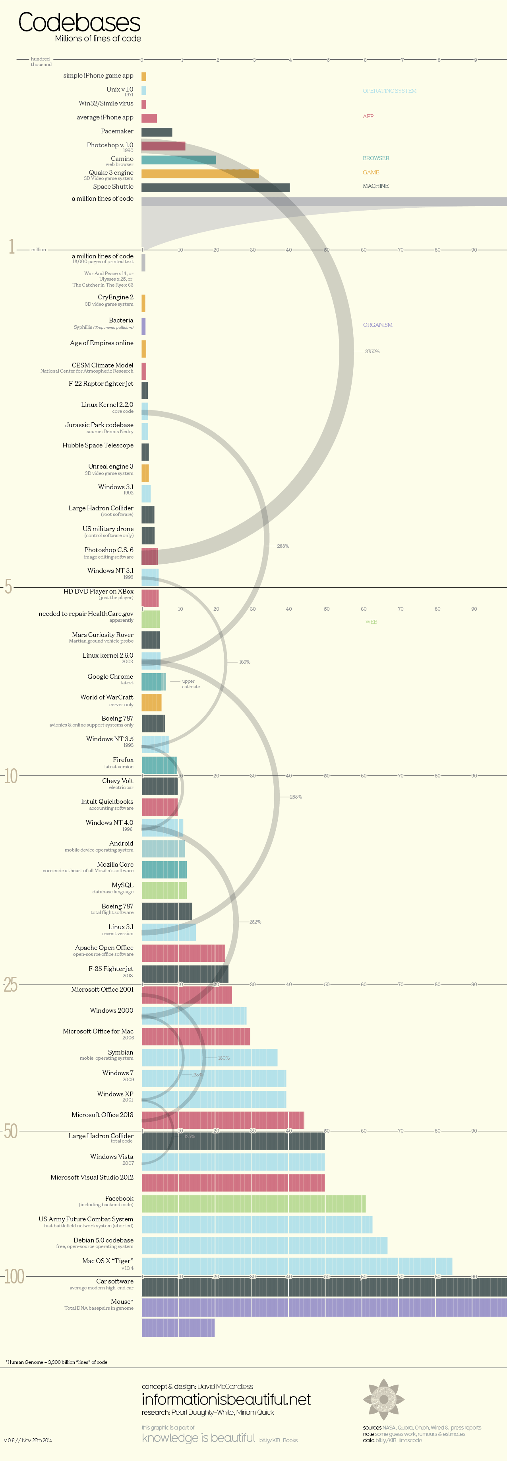
LOC (Lines Of Code)

Slide 8
Complexity of Computer Systems
Hard to define; but has some symptoms:
Large number of components
Large number of connections
Irregular
No short description
Many people required to design/maintain
Technology rarely the limit
Indeed tech opportunity is the problem
Limit is usually designers' understanding

Slide 9
System Complexity

Slide 10
Problem Types
Emergent properties (surprise!)
The properties that are not considered at design time
Propagation of effects (butterfly effort)
Small change -> big effect
Incommensurate scaling
Design for small model may not scale
Trade-offs
Waterbed effect

Slide 11
1. Emergent Properties
Features
No evident in the individual components of a system
But show up when combining those components
Might also be called surprises
An unalterable fact of life: some things turn up only when a system is built

Slide 12
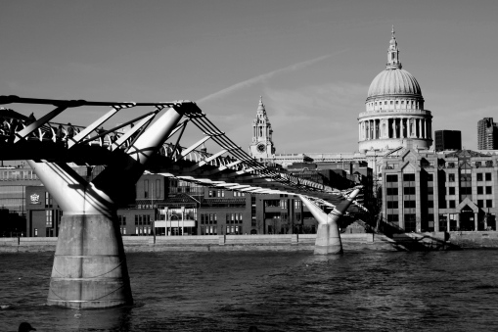
1. Emergent Properties
The Millennium Bridge
For pedestrians over the River Thames in London
Pedestrians synchronize their footsteps when the bridge sways, causing it to sway even more
It had to be closed after only a few days

Slide 13
Emergent Property Example: Ethernet
All computers share single cable
Goal is reliable delivery
Listen while sending to detect collisions
If two nodes sends data at the same time, then both cancel and wait for a random time
00011011
1101100
A
Max length: 1km
B

Slide 14
Does Collision Detection Work?
00011011
1101100
A
Max length: 1km
B
What if A finishes sending before data from B arrives?
1km at 60% speed of light = 5 ms (microseconds)
Original Ethernet Spec: 3 Mbit/sec
A can send 15 bits before bit 1 arrives at B
A must keep sending for 2*5 ms (to detect collision when first bit from B arrives)
Minimum packet size is 5*2*3 = 30 bits
The default header is 5 bytes (40 bits), so no problem for now

Slide 15
3 Mbit/s -> 10 Mbit/s, What will Happen?
First Ethernet standard: 10 Mbit/s, 2.5 km wire
Must send for 2*12.5 µseconds = 250 bits @ 10 Mb/s
Header was 14 bytes
Needed to pad packets to at least 250 bits (~32 bytes)
Emergent property: Minimum packet size!
The 250-bit minimum packet size is a surprise

Slide 16
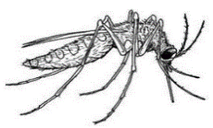
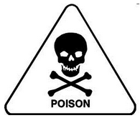
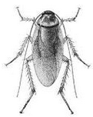
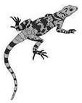


2. Propagation of Effects ^{[Cole'69]}
WHO: tried control malaria in North Borneo
Sprayed villages with DDT
Wiped out mosquitoes, but ….
Roaches collected DDT in tissue
Lizards ate roaches and became slower
Easy target for cats
Cats didn't deal with DDT well and died
Forest rats moved into villages
Rats carried the bacillus for the plague
WHO just replaced malaria with the plague

Slide 17
Example: No Small Changes
Phone network features
CF: Call Forwarding
CNDB: Call Number Delivery Blocking
The caller's number should be hidden
ACB: Automatic Call Back
IB: Itemized Billing
CF
CF
A
C
??
CNDB
ACB + IB
A calls B, B is busy
Once B is done, B automatically calls A
A's (caller) number appears on B's bill
A
B

Slide 18
3. Incommensurate Scaling
As a system increases in size or speed, not all parts of it follow the same scaling rules
So things stop working
The mathematical description
Different parts of the system exhibit different orders of growth

Slide 19
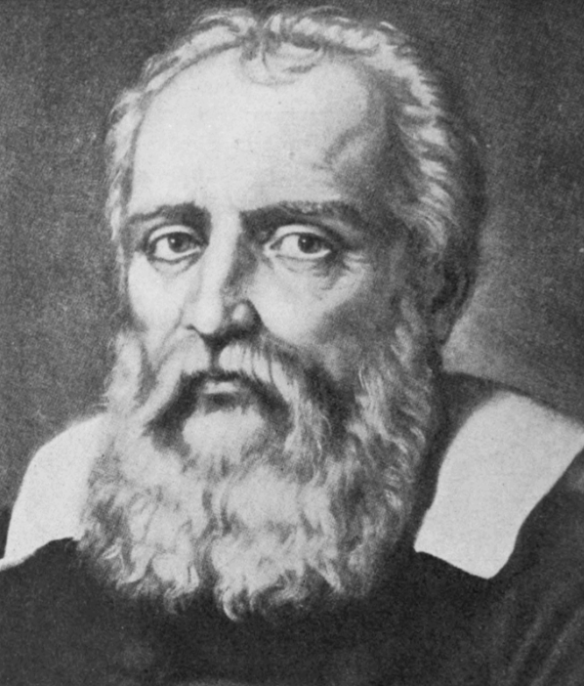
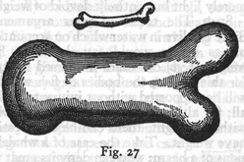
3. Incommensurate Scaling
Galileo in 1638
To illustrate briefly, I have sketched a bone whose natural length has been increased three times and whose thickness has been multiplied until, for a correspondingly large animal, it would perform the same function which the small bone performs for its small animal.
From the figures here shown you can see how out of pro- portion the enlarged bone appears.
Galileo

Slide 20
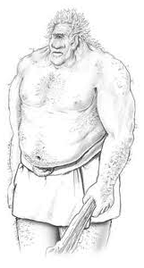
3. Incommensurate Scaling
Galileo in 1638
Clearly then if one wishes to maintain in a great giant the same proportion of limb as that found in an ordinary man he must either find a harder and stronger material for making the bones, or he must admit a diminution of strength in comparison with men of medium stature; for if his height be increased inordinately he will fall and be crushed under his own weight.

Slide 21
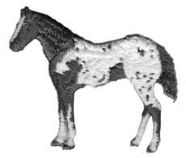

3. Incommensurate Scaling
Galileo in 1638
Whereas, if the size of a body be diminished, the strength of that body is not diminished in the same proportion; indeed the smaller the body the greater its relative strength. Thus a small dog could probably carry on his back two or three dogs of his own size; but I believe that a horse could not carry even one of his own size.

Slide 22
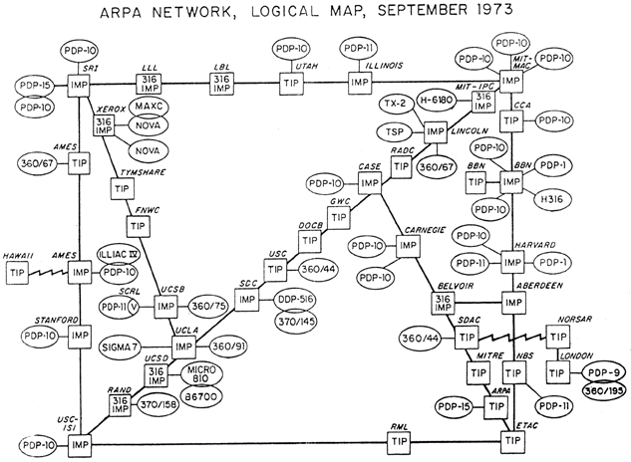
3. Incommensurate Scaling

Slide 23
Example: Scaling Figures in PPT
Bug
Bug
Bug
Bug
Original
After scaling

Slide 24
Example: Scaling the Internet
Size routing tables (for shortest paths): O(n²)
Hierarchical routing on network numbers
Address: 16-bit network number and 16-bit host number
Limited networks (2¹⁶)
Solutions:
NAT (Network Address Translators) and IPv6

Slide 25
4. Trade-offs
General models
Limited amount of goodness
Maximize the goodness
Avoid wasting
Allocate where helps most
Waterbed effect
Pushing down on a problem at one point
Causes another problem to pop up somewhere else

Slide 26
4. Trade-offs
Binary classification
We wish to classify a set of things into two categories
Based on presence or absence of some property
But we lack a direct measure of that property
So we identify some indirect measure instead
Known as a proxy

Slide 27
4. Trade-offs
Binary classification (Cont.)
Occasionally this scheme misclassifies something
By adjusting parameters of the proxy
The designer may be able to:
reduce one class of mistakes
but only at the cost of increasing some other class of mistakes

Slide 28

How to Handle?
Ideally, the "Constructive Theory"
Allows the designer systematically to
Synthesize a system from its specifications
Make necessary trade-offs with precision
Works in some fields
Communication systems
Linear control systems
Design of bridge and skyscrapers (to a certain extent)

Slide 29
How to Handle?
In Computer Systems
"We find that we were born too soon" -- Our textbook
The problems
We work almost entirely by analyzing ad hoc examples rather than by synthesizing
So, in place of a well-organized theory, we use case studies

Slide 30
Limit the Levels of Complexity
All systems are indefinitely
The deeper one digs, the more signs of complexity turn up
A computer -> gates -> electrons -> quarks -> …
Abstraction: limits the depth of digging

Slide 31
Coping with complexity
M.A.L.H

Slide 32
M.A.L.H
Modularity
Split up system
Consider separately
Abstraction
Interface/Hiding
Avoid propagation of effects
Layering
Gradually build up capabilities
Hierarchy
Reduce connections
Divide-and-conquer

Slide 33
Modularity
Analyze or design the system as a collection of interacting subsystems
Subsystems called modules
"Divide-and-conquer" technique
Modularity is the simplest, most important tool for reducing complexity
Consider interactions among the components within a module without simultaneously thinking about the components that are inside other modules
Notes:
Brain has limitation.

Slide 34
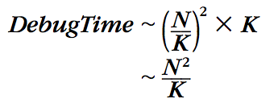
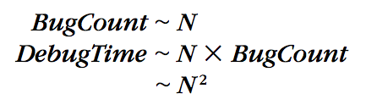
Modularity
Bug
Bug
Bug
Bug
Original System
System with Modularity
Assumptions: consider the number of bugs is proportional to its size, and bugs are randomly distributed

Slide 35
Abstraction
Abstraction
Treat a module based on external specifications, no need for details inside
Principles to divide a module
Follow natural or effective boundaries
Fewer interactions among modules (Chap.4 & 5)
Less propagation of effects

Slide 36
Abstraction
Problem: minimizing interconnections among modules may be defeated
Unintentional or accidental interconnections, arising from implementation errors
Well-meaning design attempts to sneak past modular boundaries
Improve performance
Meet some other requirement
Notes:
E.g., OSDI'12 socket optimization~

Slide 37
Abstraction
Software is particularly subject to this problem
The modular boundaries provided by the separately compiled subprograms are actually somewhat soft
Is easily penetrated by errors in:
using pointer;
filling buffer;
calculating array index;
etc.
Notes:
Java: using get() instead of read field directly.
Buffer overflow attack.

Slide 38
Abstraction
Failure containment
When a module does not meet its abstract interface specifications
Limiting the impact of faults
Well-designed and properly enforced modular abstractions
Control propagation of effects
Modules are the units of fault containment
Notes:
What about data flow?

Slide 39
Layering
Goal: Reduce module interconnections even more
How to do it?
Build a set of mechanisms first (a lower layer)
Use them to create a different complete set of mechanisms (an upper layer)
General rule: A module in one layer only interacts with:
its peers in the same layer, and
modules in the next lower layer / next higher layer

Slide 40
Layering
Application layer
OS layer
Processor & memory layer
Memory cells & gates layer
House:
Inner layer of studs, joist, rafter (shape & strength )
Layer of sheathing and drywall (wind out)
Layer of siding, flooring and roof tiles (watertight)
Cosmetic layer of paint (looks good)
Algebra:
integer, complex number, polynomials, polynomials with polynomial coefficients

Slide 41
Hierarchy
Hierarchy: another module organization
Start with a small group of modules
Assemble them into a stable, self-contained subsystem with well defined interface
Assemble a group of subsystems to a larger subsystem
Example
1 manager leads N employees
1 higher manager leads N lower managers

Slide 42
Hierarchy
There are many striking examples of hierarchy
E.g., microscopic biological systems, assembly of Alexander's empire
Under evolution, such designs have a better chance of survival
Constrains interactions
Permit interaction only among the components of a subsystem
Reduces the number of potential interactions among modules from square-law to linear

Slide 43
Computer systems are different

Slide 44
Computer Systems are Different
Computer systems are the same as all other systems
Certain common problems show up in all complex systems
The techniques that have been devised for coping with complexity are universal
Yet, computer systems are different (sadly)
The complexity is not limited by physical laws
The rate of change of technology is unprecedented

Slide 45
Unbounded Composition
Two properties of computer systems
1. Mostly digital
2. Controlled by software
Both relax the limits on complexity arising from physical laws in other systems

Slide 46
Computer System: Coping with Complexity
M.A.L.H are NOT enough
Hard to choose the right modularity
Hard to choose the right abstraction
Hard to choose the right layer
Hard to choose the right hierarchy

Slide 47
Class Plan
File System: Abstraction and layering
Enforced Modularity: Client & Server, virtualization
Performance: Systematic way for optimization
Network: Different layers, resource management
Fault Tolerance: Replication, logging
Transaction: Atomicity, isolation, consistency, availability
Security: threat model, authentication, attacking

Slide 48
Scores
Mid-Exam: 25%
Final-Exam: 35%
Lab: 30%
Homework: 10%

Slide 49

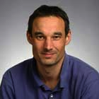
Textbook
Principles of Computer System Design: An Introduction
Jerome H. Saltzer & M. Frans Kaashoek, June 2009.
Others
Computer Systems: An Integrated Approach to Architecture and Operating Systems
Distributed Systems: Principles and Paradigms, 2nd Edition

Slide 50
Where is CSE in Courses
Operating Systems
Architecture
Compilers
Networking
Computer Systems Engineering
Introduction to Computer Systems

Slide 51
Course Info
Website
https://ipads.se.sjtu.edu.cn/courses/cse/
TAs
Mingyu Wu: timberonce@gmail.com
Ziming Zhao: dumplings_ming@126.com
Fuqian Huang: hfq_zyx@163.com
Xu Lu: 1603155230@qq.com

